Slide 1
HELLO, DEAR STUDENTS!

Slide 2
How are you today?
Today I am …
Sad
Bored
Sleepy
Tired
Nervous
Happy
Interested
Optimistic
Energetic
Fine

Slide 3
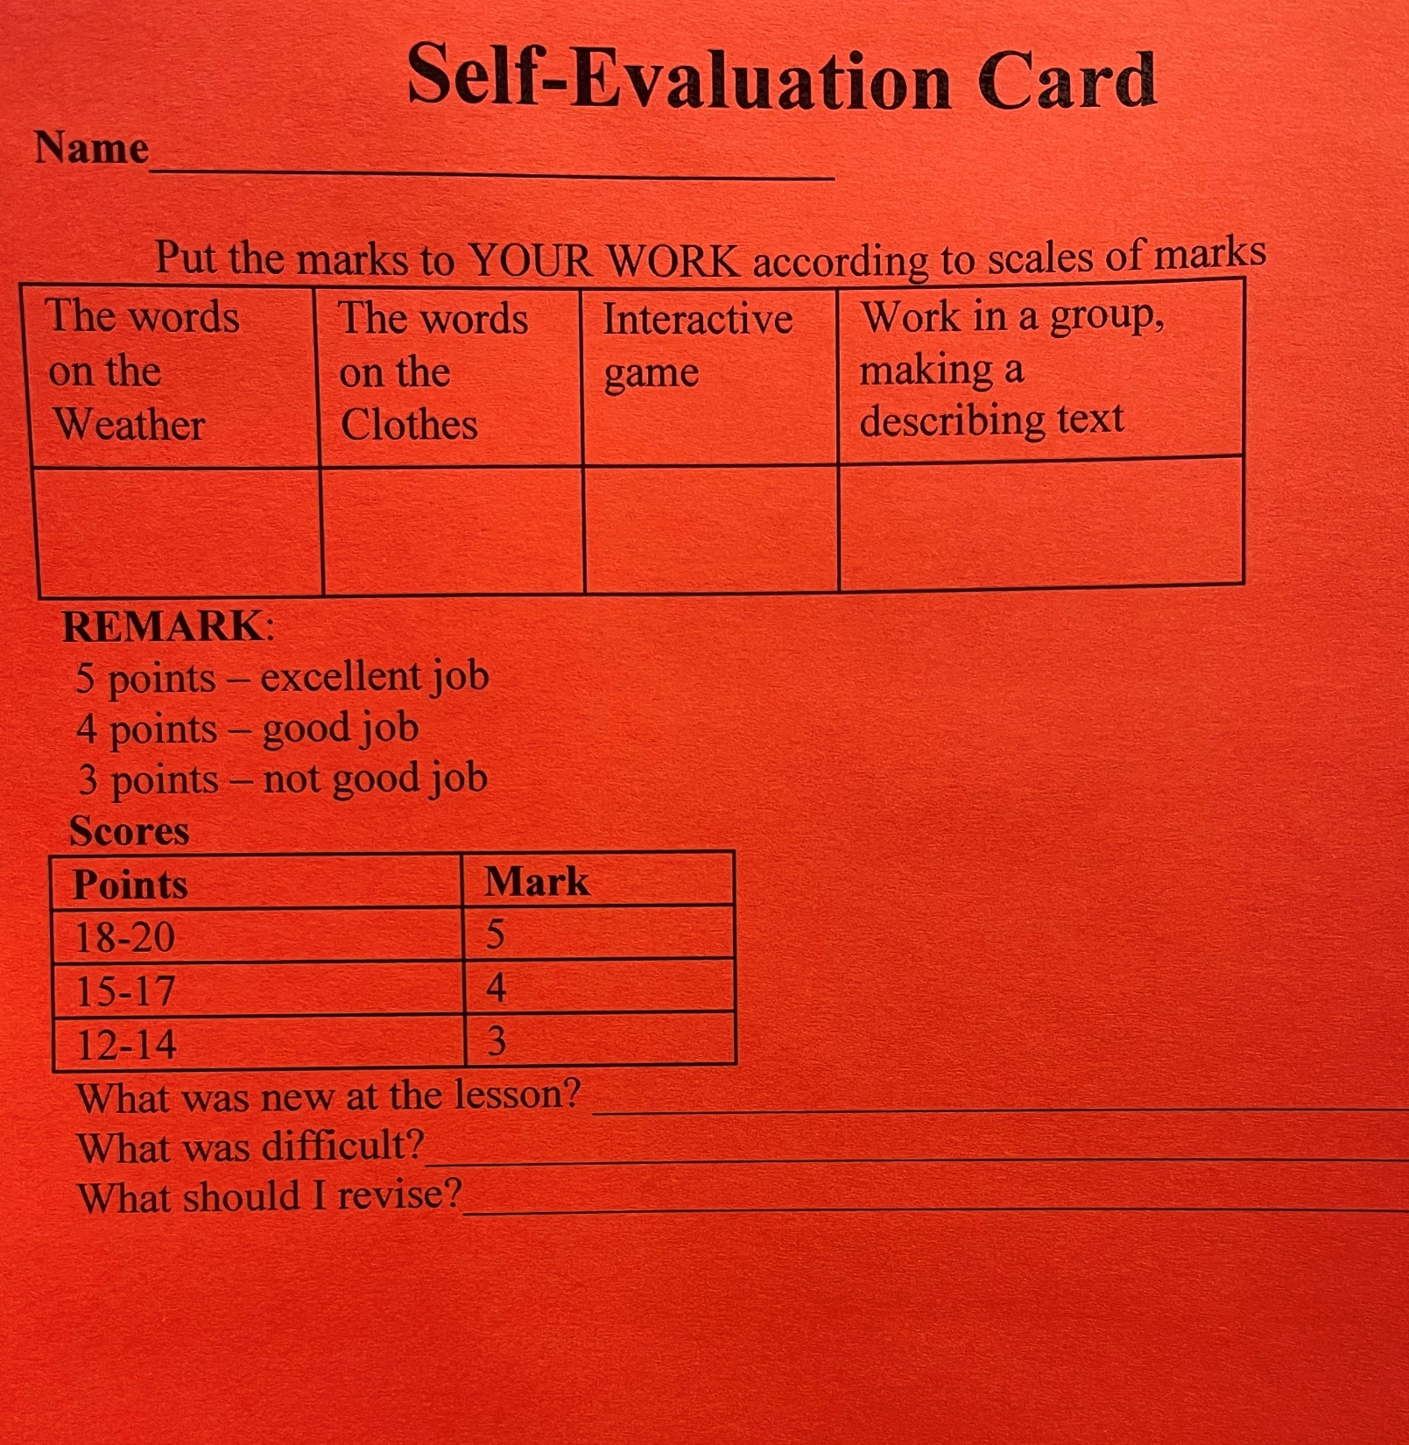

Slide 4
Whether the weather is cold,
Whether the weather is hot,
We’ll weather the weather
whatever the weather,
Whether we like it or not.

Slide 6
Weather & Clothes

Slide 7
Our aim is:
To learn the words about weather and clothes by heart
We are going to:
Do the phonetics
Read the words
Make up sentences
Listen to the recordings
Good luck and do your best!

Slide 8
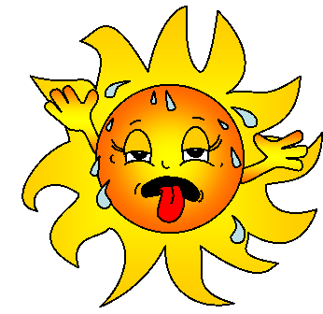
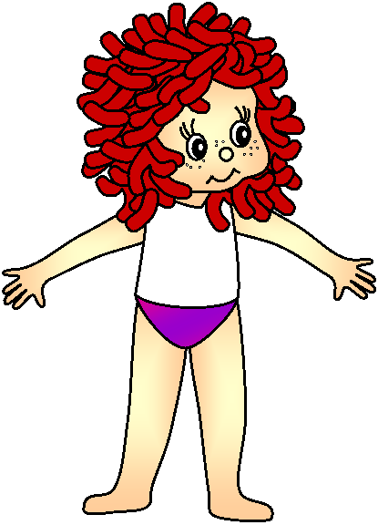
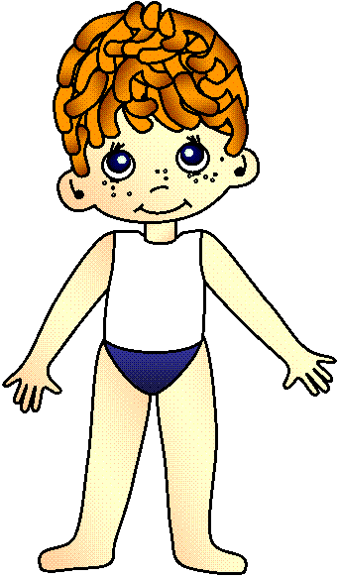
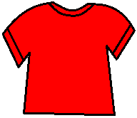

Slide 9
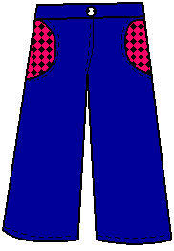
It’s ________!
hot
Wear your shorts!
Put on your top!

Slide 10
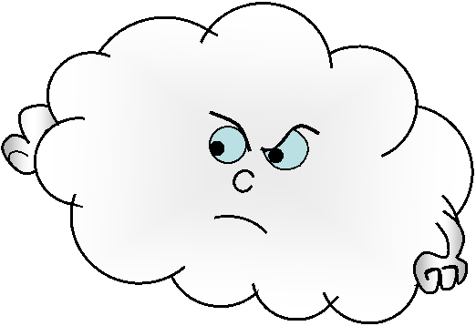
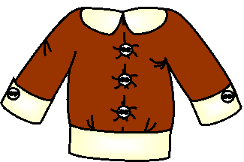
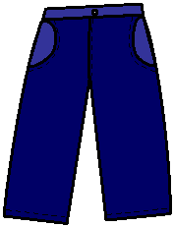
cloudy
It’s ________!
Take off your shirt!
Put on your sweater!

Slide 11
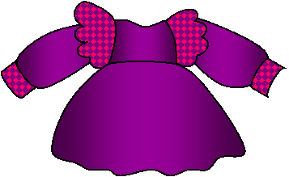
It’s ________!
sunny
Take off your sweater!
Put on your dress !

Slide 12
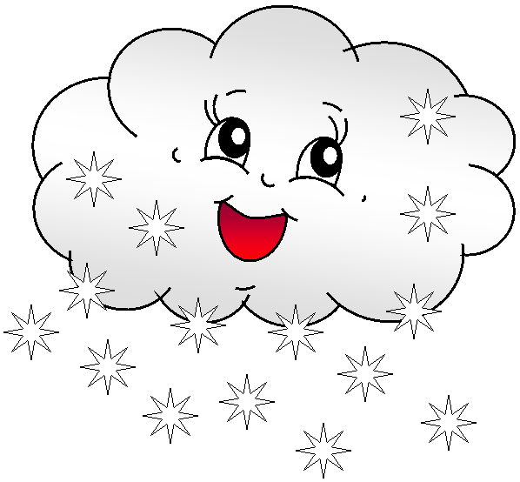
It’s ________!
snowy
Wear your jacket!
Put on your gloves!

Slide 13
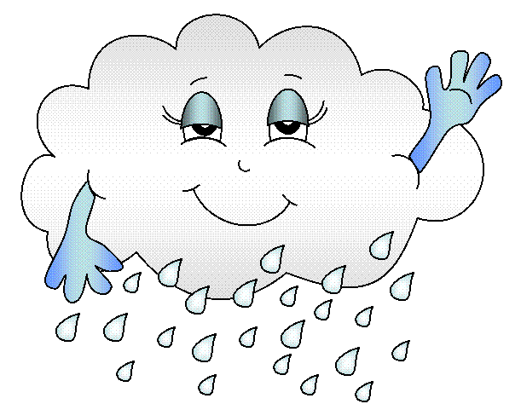
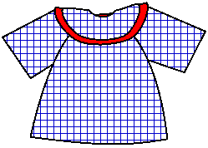
It’s ________!
rainy
Wear your trainers!
Take your umbrella!

Slide 14
Physical exercises!

Slide 15
Our mood might change. The weather might change too. Does our mood depend on the weather? Of course, it does. Especially if we are not dressed right.

Slide 16
Dress your doll!
Plan:
Hello! I’m __________ (name).
Today is __________ (kind of weather).
I’m wearing ___________ (names of clothes).

Slide 18
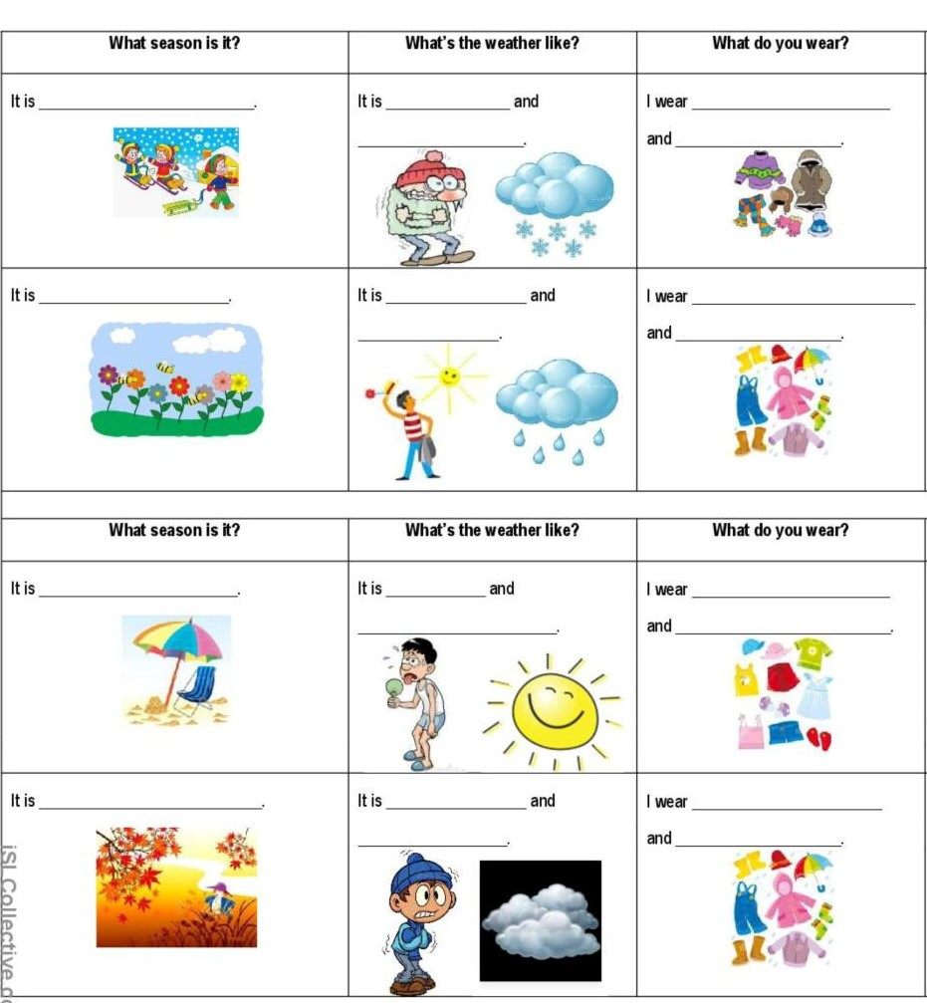
Home task

Slide 20
Thanks for your work!
Good bye!

