Slide 1
CITY & COUNTRY

Slide 2
TODAY’S GOALS
To remember the words and word combinations, to practice them

Slide 3
READ AND TRANSLATE
to live in the country
heavy traffic
convenient
public transport
fresh air
pollution
high/low rate of unemployment
to live in the city
high/low cost of living
crowded streets
lifestyle
huge
peace and quiet
lead
constant

Slide 4
PUT THE LETTERS INTO CORRECT ORDER
s,l,f,t,i,e,y,e,l
t,p,l,o,u,l,i,n,o
v,i,n,c,o,n,t,e,e,n
t,y,c,i
e,h,g,u
y,n,c,u,o,r,t
r,c,d,w,o,e,d
l,t,m,n,y,e,u,n,m,p,o,e

Slide 5
MATCH THE WORDS TO MAKE THE WORD COMBINATIONS
to milk | air
to feed | and bustle
close | at hand
constant | of living
peace | noise
hustle | the chickens
convenient | a cow
fresh | public transport
the cost | streets
crowded | and quiet

Slide 6
FILL IN THE CORRECT WORDS
LEAD CONSTANT CONVENIENT UNEMPLOYMENT ISOLATED LANDSCAPES
Very few people ___________ a healthy lifestyle in big cities.
Our house is next to the train station, which is very _____________.
Many young people have to deal with _________________ when they finish their studies.
Thailand is a country with amazing _______________.
I can’t study when there’s ___________ noise around me.
She lives in a(n) _______________ sea in Northern Norway.

Slide 7
TRANSLATE INTO RUSSIAN
1. ЖИЗНЬ В СЕЛЕ ПОЛЕЗНЕЕ ДЛЯ ЗДОРОВЬЯ.
2. УРОВЕНЬ БЕЗРАБОТИЦЫ В ДЕРЕВНЕ ВЫШЕ.
3. В ГОРОДЕ ОЖИВЛЕННОЕ ДВИЖЕНИЕ.
4. СТОИМОСТЬ ЖИЗНИ В ГОРОДЕ ВЫСОКАЯ.

Slide 8
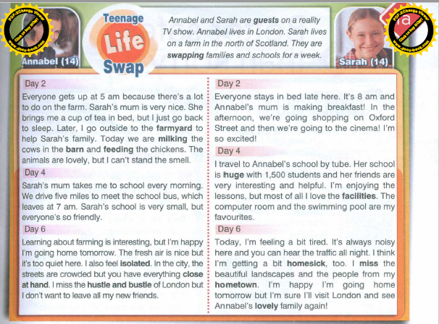
HOME ASSIGNMENT

