Slide 1
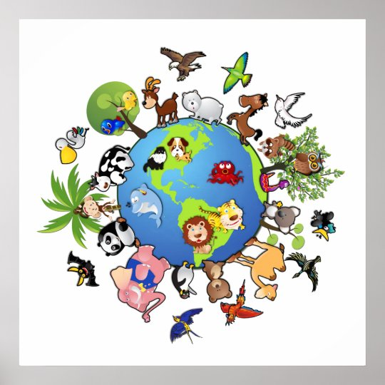
Living things around us

Slide 2
Today’s goals (цели)
to learn new words
to practice them
DO YOUR BEST!

Slide 3
Read the names of birds and translate them
a turkey
a goose
a duck
an ostrich
a magpie
a starling
a nightingale
a woodpecker
a crow
an owl
a pigeon
a seagull
a swallow
a sparrow
a parrot
a swan
a budgie
an emu
a kookaburra
a canary

Slide 4
Name the bird
1. This is a seabird. It feeds mostly on fish and often follow ships.
2. A bird with a strong narrow beak. People sometimes call it the “doctor” of trees.
3. This bird lives in Africa, Australia and South America. People often keep them as pets and teach them to talk.
4. It’s a small bird. People usually say that it can sing better than any other. It usually sings at night or in the early hours of the morning.
5. This black-and-white bird lives in the woods and forests, but people often see it near their houses. The bird has a long tail and a loud cry.
6. This bird is larger than a sparrow but smaller than a crow. It can be blue-grey, grey, sometimes white or brown. Some time ago people use them to carry short letters.
7. A large water bird, usually white, sometimes black in colour, it has a long neck and flies to the south in autumn.
8. A night bird with large round eyes, it hunts and eats small animals.

Slide 5
Divide birds into small groups
Water birds:
swan, seagull
Song birds:
nightingale, canary
Forest birds:
nightingale, magpie
Town birds:
pigeon, sparrow
Wild birds:
crow, kookaburra
Domestic birds:
turkey, duck
Talking birds:
parrot
Birds that make good pets:
canary, budgie

Slide 6
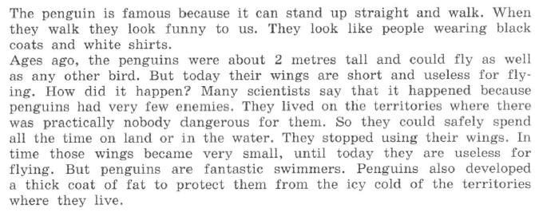
Read the text and translate (SB p.9 ex.3)

Slide 7
Find the English equivalents in the text (SB p.9 ex.3)
Пингвины известны тем, что…
Они кажутся нам смешными
Много лет назад
Два метра ростом
Так же хорошо, как и…
У них короткие крылья
Как это случилось?
Очень мало врагов
Они перестали использовать крылья

Slide 8
Listen to the recording and decide which of the facts is not stated in the text
Kiwi birds are not very big birds.
For a long time kiwi birds did not have any enemies on the land where they lived.
Kiwi birds are disappearing.
The kiwi is the bird that is symbol of New Zealand.
It is not easy to see kiwi birds because of their colour.
It is possible to say that kiwi birds are night birds.

Slide 9
Home task
SB p.7 ex.5 A,B (to learn birds’ names)
SB p.12 ex.8
SB p.10 (to write down the rule in a copybook)

