Slide 1
HOLIDAYS

Slide 2
Today’s goals (цели)
to learn irregular verbs
to revise and remember some grammatical rules and practice them
DO YOUR BEST!

Slide 4
Checking home task. SB English, p.6 ex.2.2)

Slide 5
Fill in the table
PAST SIMPLE | PAST PROGRESSIVE | PAST PERFECT

Slide 6
Fill in the table
IRREGULAR VERBS
go | went |  | идти
be |  | been | быть
 |  |  | класть
have | had | had
 | felt | felt | чувствовать
swim |  | swum | плавать
write | wrote | written
know |  | known | знать
 | took | taken | брать
come | came | come
 |  |  | читать
talk | told | told

Slide 7
Do the task
*can-could
get-got-got

Slide 8
Check up your answers
PAST SIMPLE | PAST PROGRESSIVE | PAST PERFECT
had | were walking | had been
were |  | hadn’t seen
was (3)
went (3)
didn’t see
swam
took
Total: 14

Slide 9
IRREGULAR VERBS
go | went | gone | идти
be | was\were | been | быть
put | put | put | класть
have | had | had | иметь
feel | felt | felt | чувствовать
swim | swam | swum | плавать
write | wrote | written | писать
know | knew | known | знать
take | took | taken | брать
come | came | come | приходить
read | read | read | читать
talk | told | told | говорить
Total: 16

Slide 10
Total: 5

Slide 11
Check up your answers
RESULTS
32-35 – “5”
27-31 – “4”
22-26 – “3”
20≥ - TRY AGAIN!

Slide 12
Reflection

Slide 13
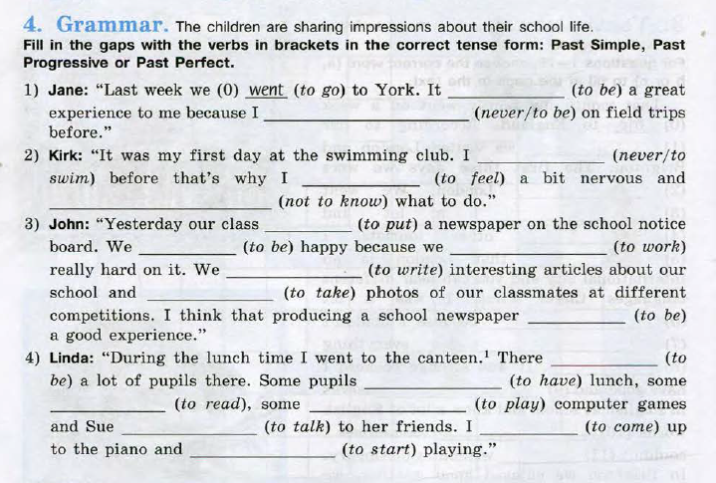
Home task
SB English p.12 ex.4

