Slide 3
Today’s goals (цели)
to learn the words and word combinations,
to use them in translations,
to revise and remember some grammatical rules and to use them in speech
DO YOUR BEST!

Slide 4
Divide the words in two columns: countable and uncountable nouns
COUNTABLE
UNCOUNTABLE
sweets
lemonade
oranges
biscuits
meat
chocolate
cheese
sugar
lemons
tea
cola
juice
coffee
bread
carrots
salt
milk
jam
olive oil
butter
eggs
water
tomatoes
soup
apples
cakes
bananas
sandwich
onions

Slide 5
Let's do some exercises!
COUNTABLES | UNCOUNTABLES
CLAP YOUR HANDS | STOMP YOUR FEET

Slide 6
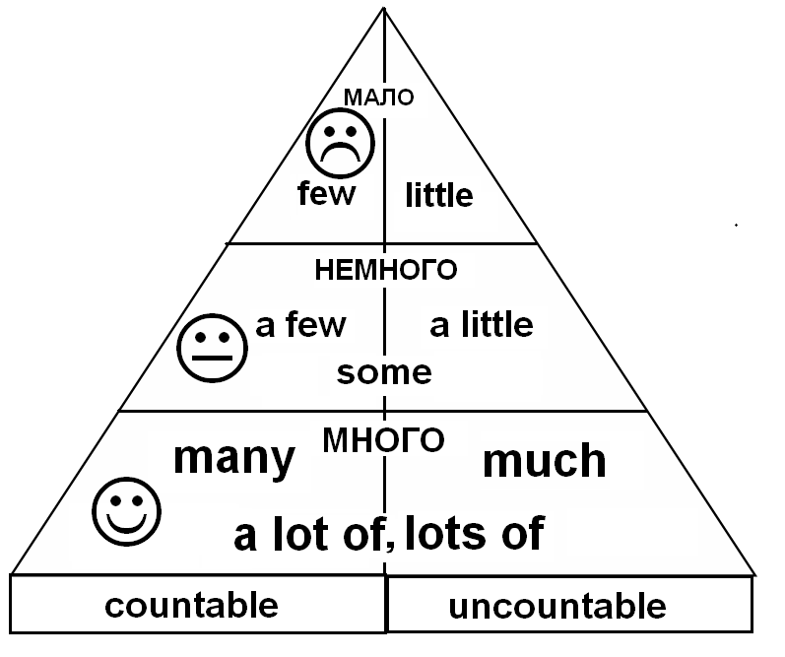
Refresh the rule! Вспомни правило!

Slide 7
Work in pairs. Say to your partner word combinations with the word from your card. Write them down.
Example:
Many carrots
A few carrots
Few carrots
Much milk
A little milk
Little milk

Slide 8
Choose the correct word in brackets to complete the sentences
There is (few/little) milk left.
I have (many/much) apples.
Please, buy (a few/a little) eggs.
Translate into English
Пожалуйста, купи немного бананов.
У меня много шоколада.
Воды осталось мало.

Slide 9
Please, buy a few bananas.
I have much chocolate.
There is little water left.

Slide 10
Reflection

Slide 11
Divide the words in two groups: countable and uncountable nouns
COUNTABLE
UNCOUNTABLE
CHEESE EGGS MILK BREAD WATER SANDWICH JUICE
BUTTER TOMATOES CARROTS

Slide 12
Choose many/much, few/little, a few/a little
(many/much) apples
(many/much) milk
(few/little) tea
(a few/a little) jam
(a few/a little) bread

Slide 13
Check up your answers
COUNTABLE
CHEESE
EGGS
SANDWICH
TOMATOES
CARROTS
(many/much) apples
(many/much) milk
(few/little) tea
(a few/a little) jam
(a few/a little) bread
UNCOUNTABLE
MILK
BREAD
WATER
JUICE
BUTTER
RESULTS
15 – “5”
13-14 – “4”
9-12 – “3”
≥8 - TRY AGAIN!

Slide 14
Thanks for your work! Good bye!

